Slide 1

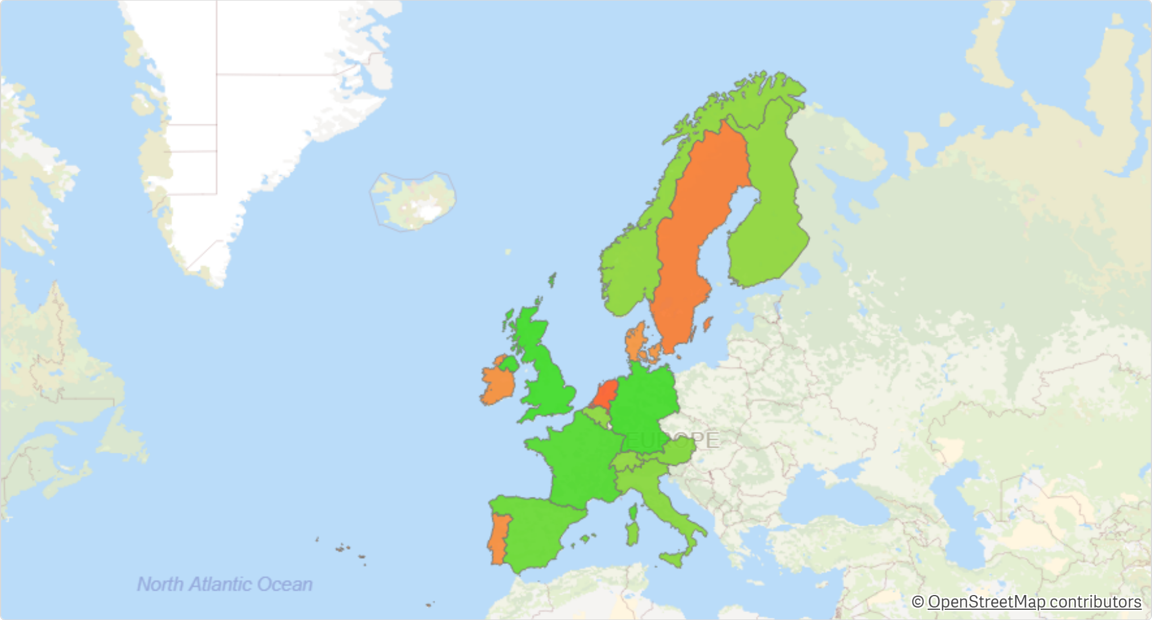
Profit Insight
Profit by countries

Slide 2
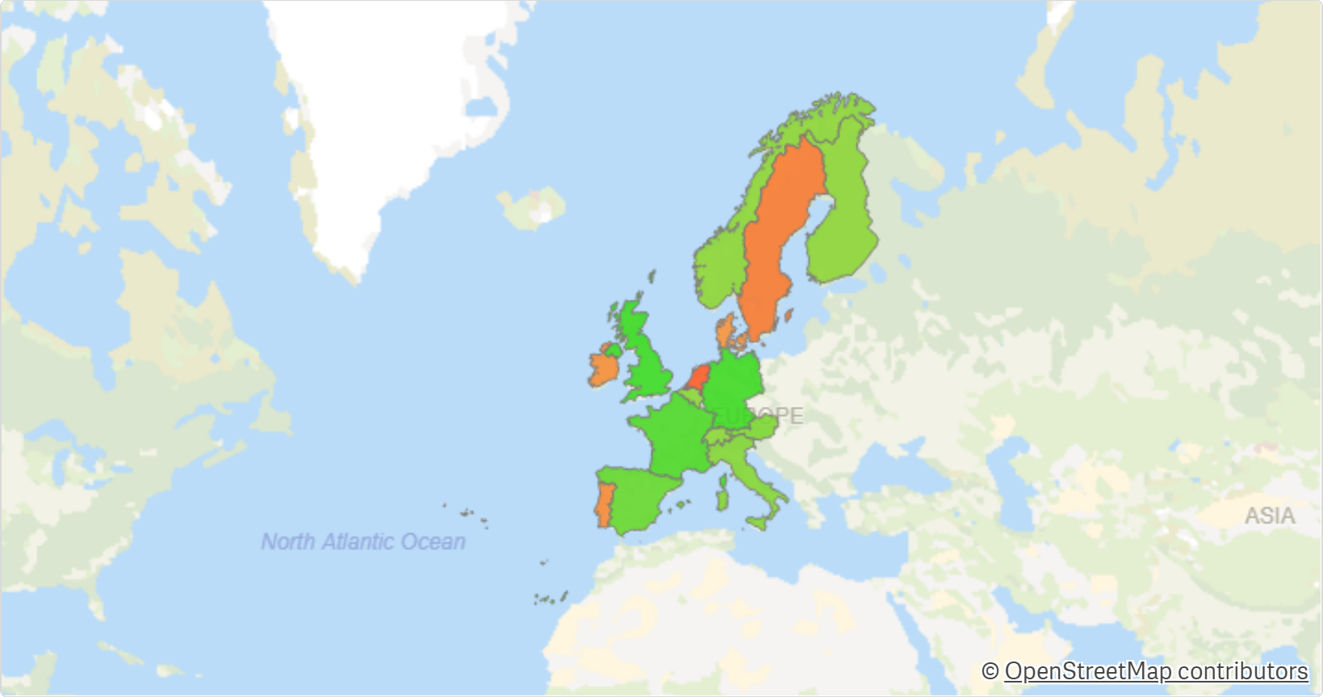
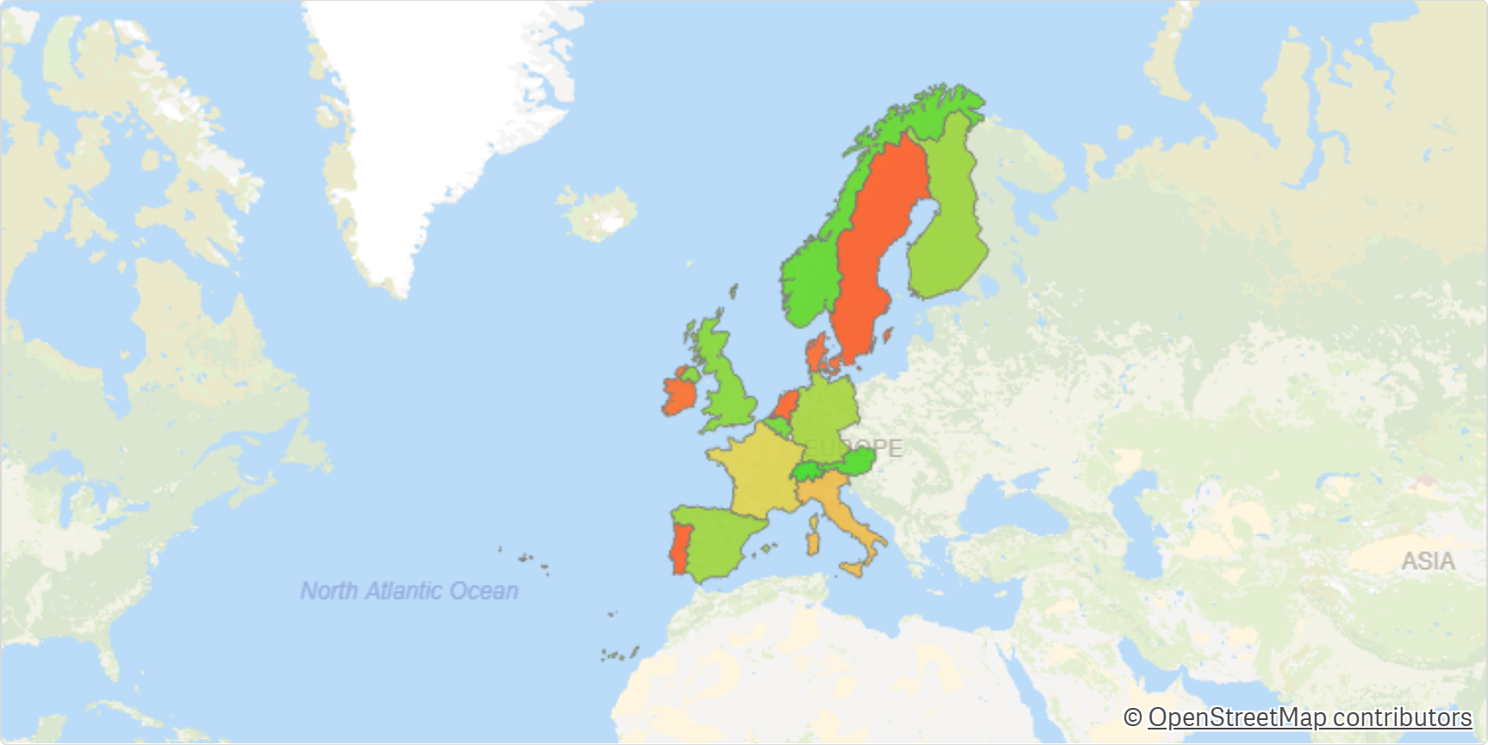


Italy and France have low Gross Profit Margin %
in comparison to their Profit
Profit by countries
Gross Profit Margin % across countries

Slide 3

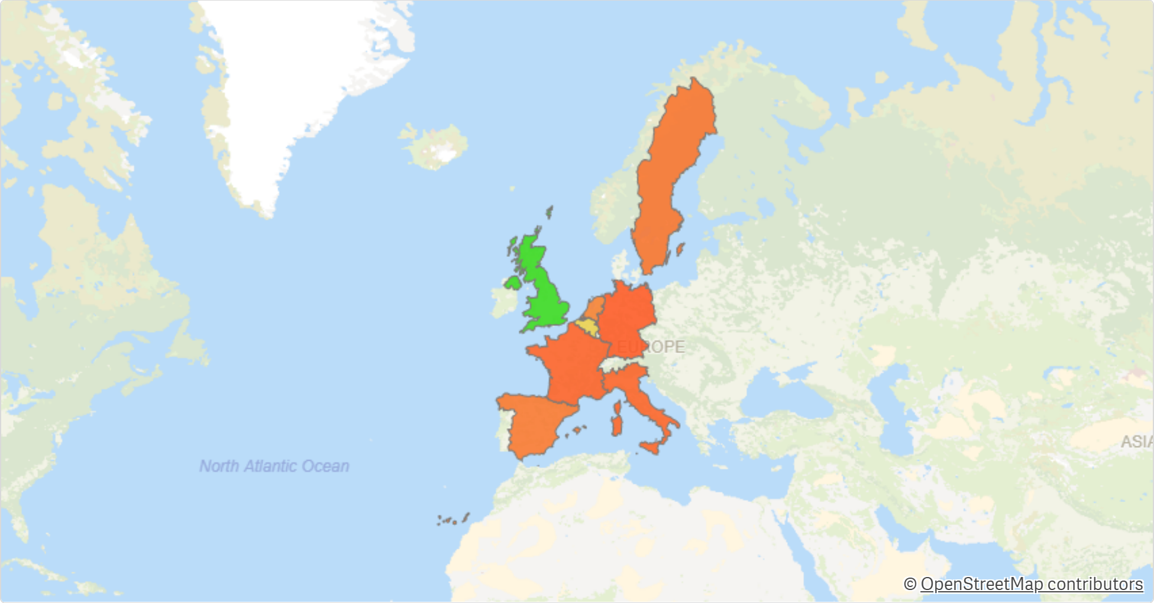
Tables (sub-category)
have the lowest Profit...
...except in UK!

Slide 4
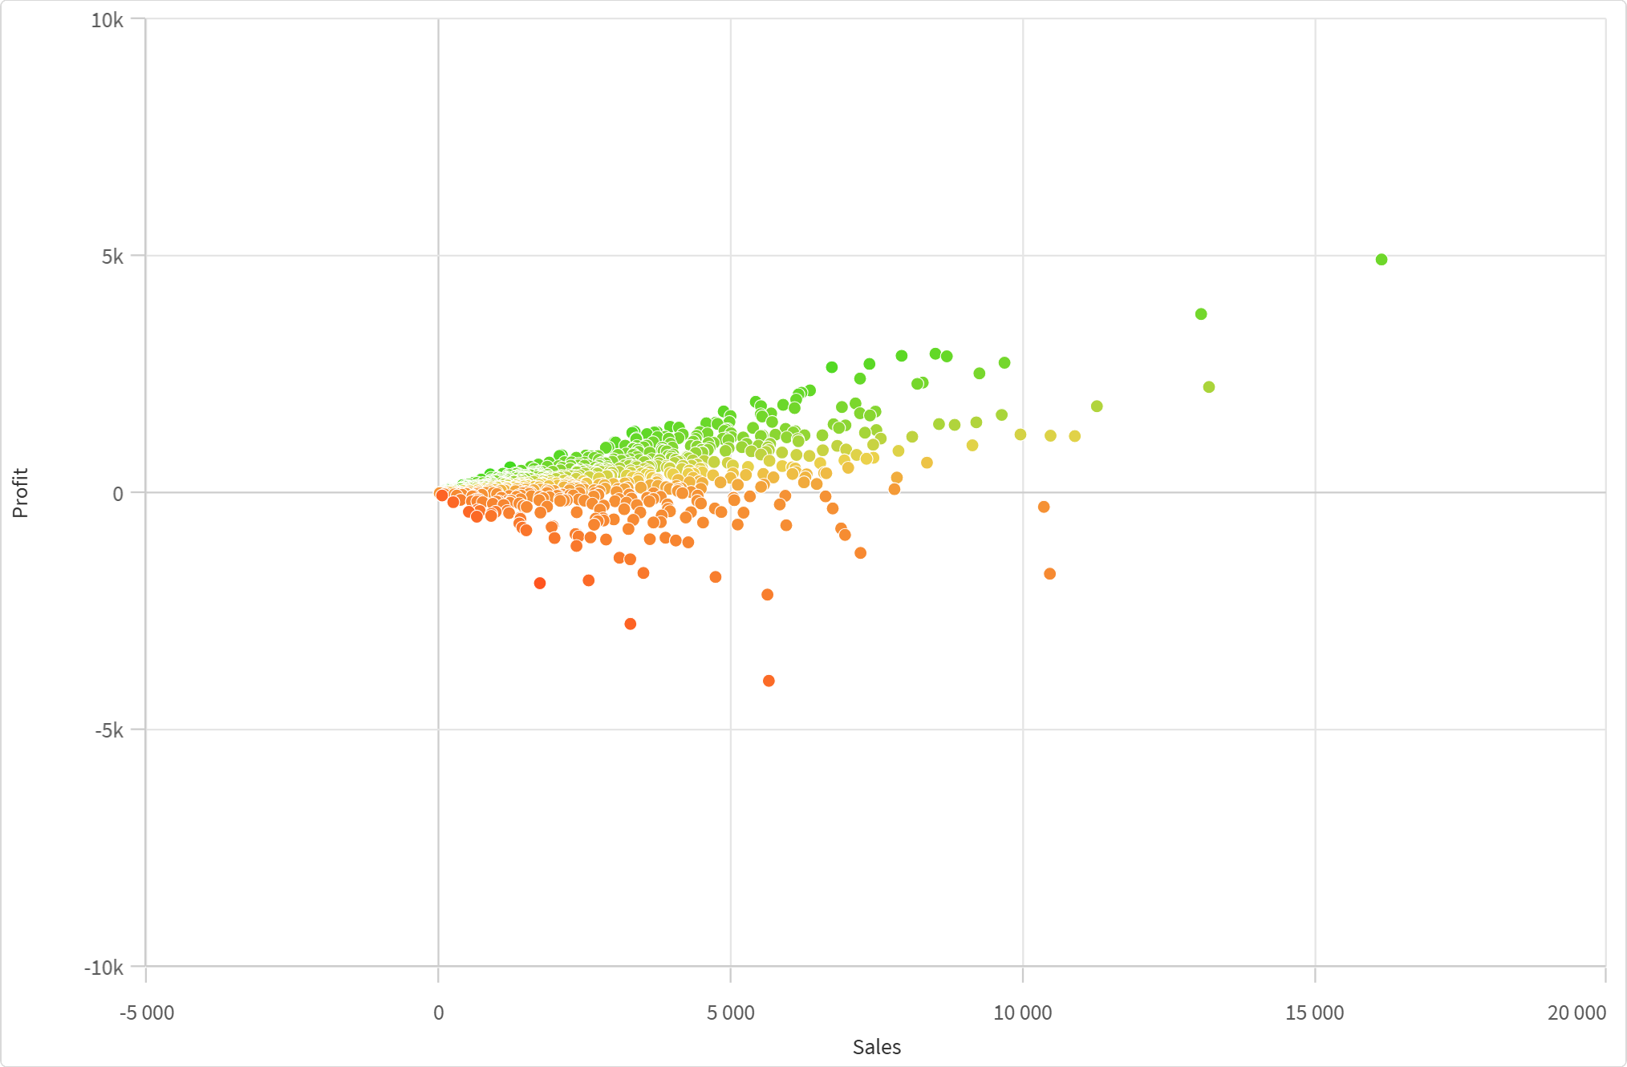


Customers with similar sales...
...what makes them profitable?

Slide 5




